Slide 1
MIPI-DSI

Slide 2
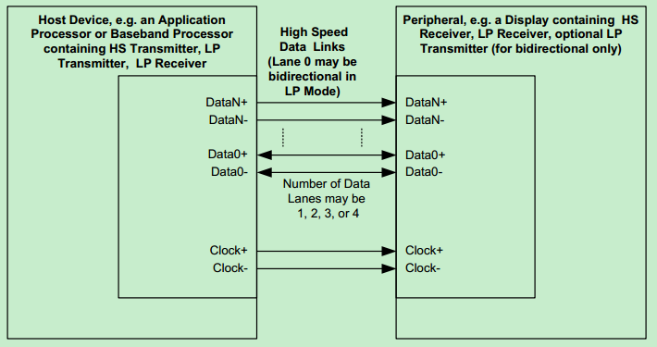
DSI specifies the interface between a host processor and a peripheral such as a display module.
DSI Transmitter and Receiver Interface

Slide 3

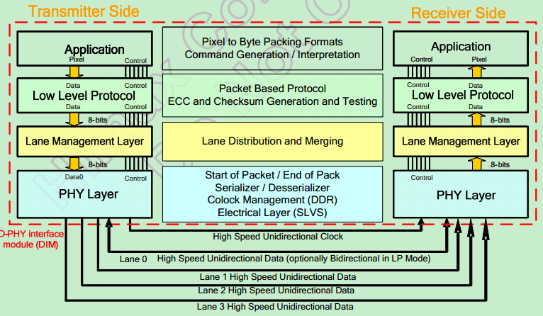
DSI transmitter and receiver interface

Slide 4
PHY Layer：
specifies the characteristics of transmission medium and electrical parameters for signaling the timing relationship between clock and Data Lanes.
2.Lane Management Layer:
DSI is Lane-scalable for increased performance. The data signals maybe transmission through one or more channel depending on the bandwidth requirements of the application.
3.Protocol Layer：
pecifies the sequence and value of bits and bytes traversing the interface. It specifies how bytes are organized into defined groups called packets.
4.Application Layer：
describes higher-level encoding and interpretation of data
contained in the data stream.

Slide 5
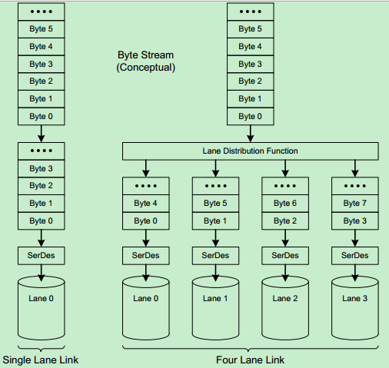
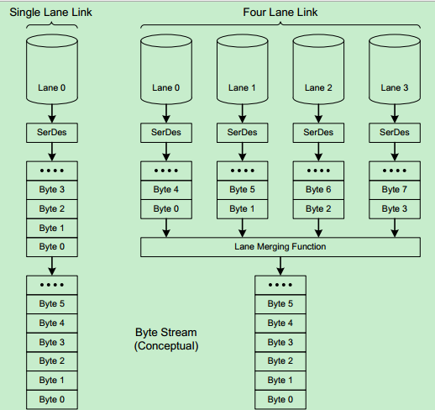
Lane Distributor Conceptual Overview
Lane Merger Conceptual Overview

Slide 6

command mode:
The host processor indirectly controls activity at the peripheral by sending commands, parameters and data to the display controller.
The minimum physical layer requirement :
• Data Lane Module: CIL-MFAA (HS-TX, LP-TX, LP-RX, and LP-CD)
• Clock Lane Module: CIL-MCNN (HS-TX, LP-TX)
2. video mode:
operation in which transfers from the host processor to the peripheral take the form of a real-time pixel stream in High Speed Mode.
The minimum physical layer requirement :
• Data Lane Module: CIL-MFAN (HS-TX, LP-TX)
• Clock Lane Module:CIL-MCNN (HS-TX, LP-TX)

Slide 7
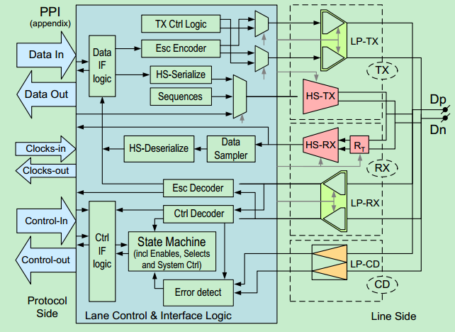

Slide 8
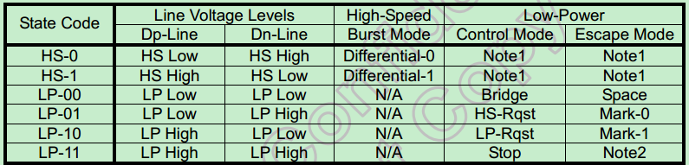
The state code of HS and LP Lane pair are defined as below:
LP mode
each line of the differential pairs are used in independently and
single-ended.
HS mode
the differential pairs are not used in single-end and termination
resistor of the receiver is enable.

Slide 9
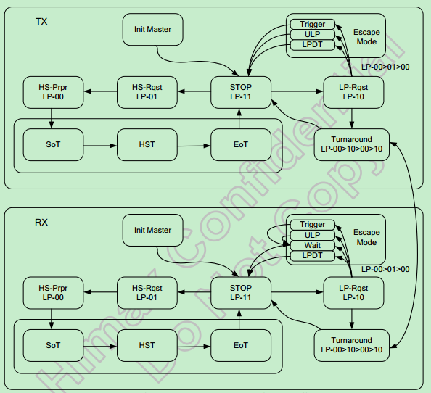
operational flow diagram for Data Lane Mode

Slide 10

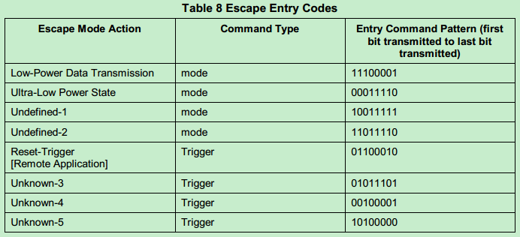
enter Escape mode:
LP-11 -> LP-10 -> LP-00 -> LP-01 -> LP-00
exit Escape mode:
LP-10 -> LP-11

Slide 11
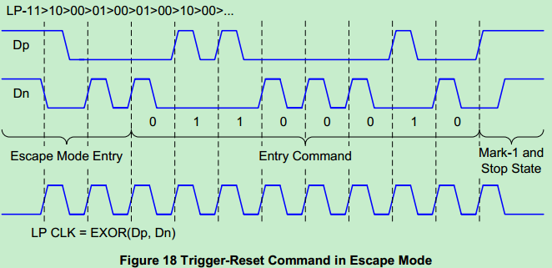

Slide 12
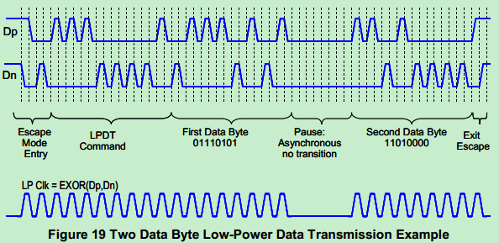

Slide 13
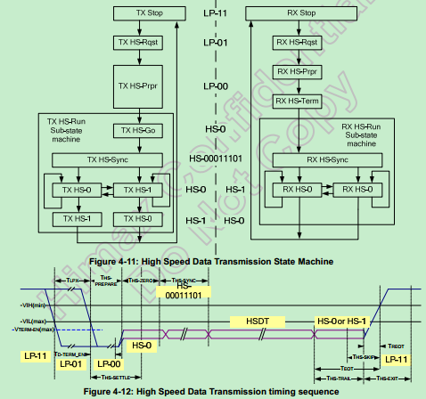
Data Lane enter High Speed Data Transmission flow: LP-11 -> LP-01 -> LP-00 -> SoT(0001_1101).
exit High Speed
Data Transmission flow: Toggles differential state immediately after last payload data
bit and keeps that state for a time T HS −TRAIL

Slide 14

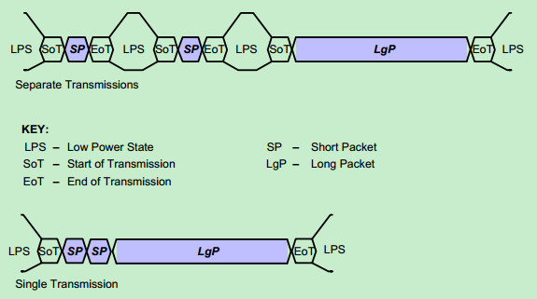
Multiple Packets per Transmission

Slide 15

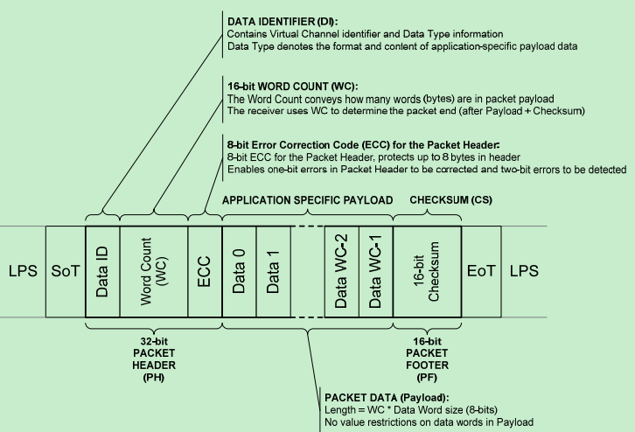
Long Packet Structure

Slide 16
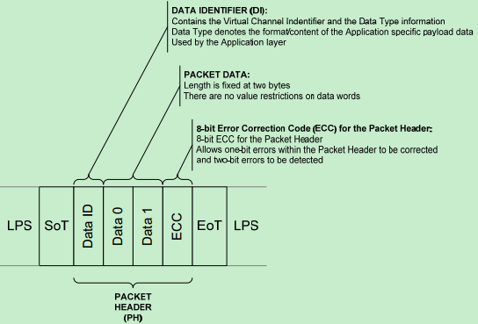
Short Packet Structure

Slide 17
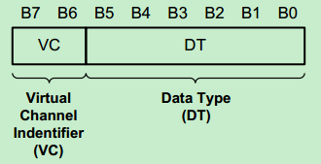
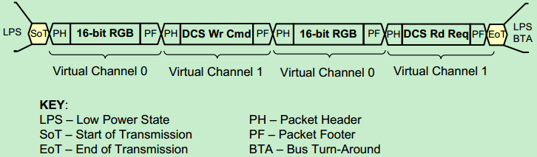
Data Identifier Byte
Interleaved Data Streams

Slide 18
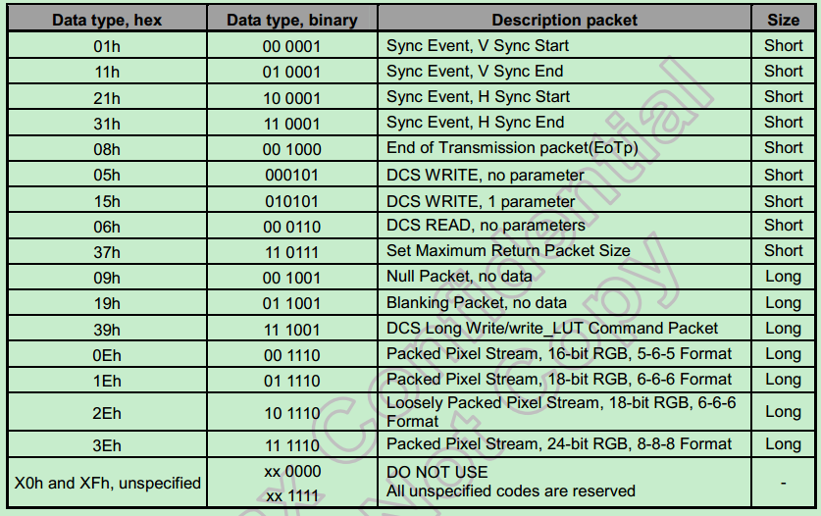
Data types for processor-sourced packets

Slide 19
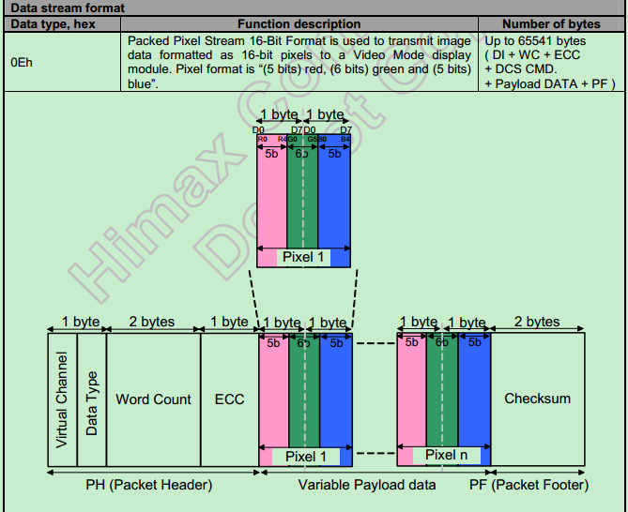

Slide 20
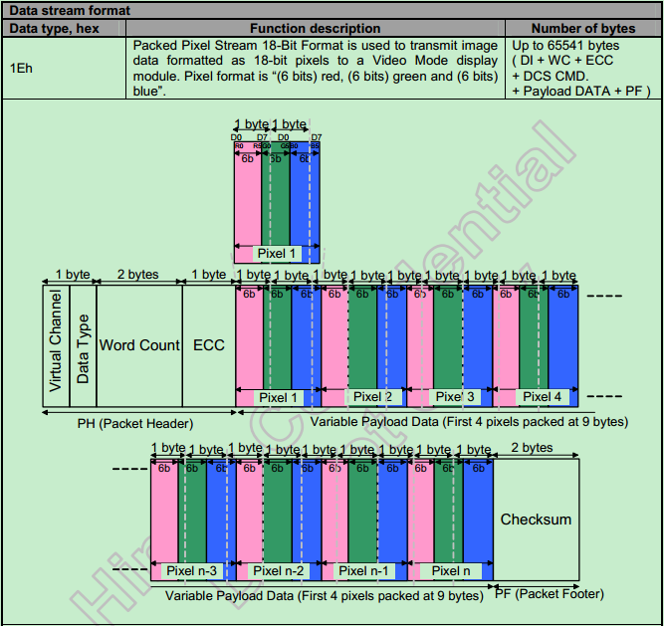

Slide 21
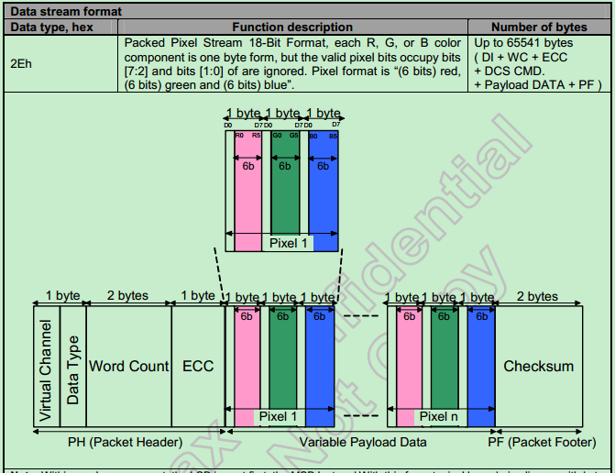

Slide 22
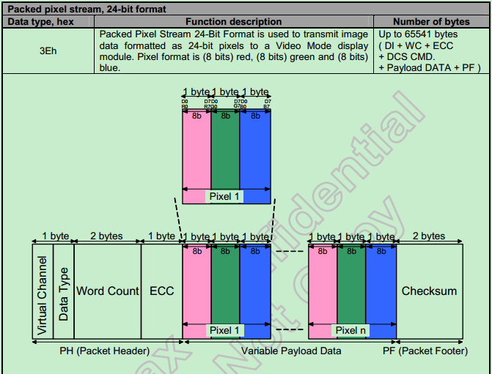

Slide 23

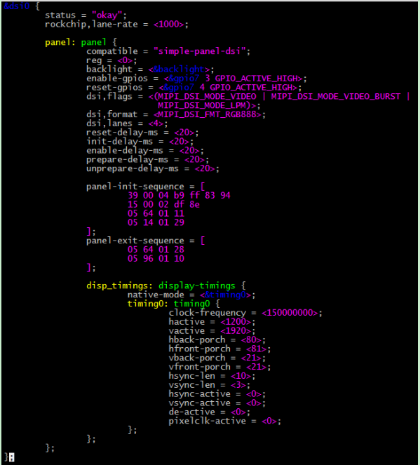

Slide 24
property | comment | property | comment
rockchip,lanerate | 指定lane-rate | reset-delay-ms | reset有效脉冲宽度
compatible | 匹配屏驱动 | init-delay-ms | 发送初始化命令之前的延时
reg | Dsi虚拟通道 | enable-delay-ms | 开启背光之前的延时
backlight | 引用背光节点 | prepare-delayms | 准备显示延时
enable-gpios | 屏使能gpio | unpreparedelay-ms | 屏掉电延时
reset-gpios | 屏reset gpuio | panel-initsequence | 屏初始化序列
dsi,flags | Dsi host 的一些 flag 选项 | panel-exitsequence | 屏下电序列
dsi,format | Pixel format | disp_timings
dsi,lanes | 可扩展通道数

Slide 25
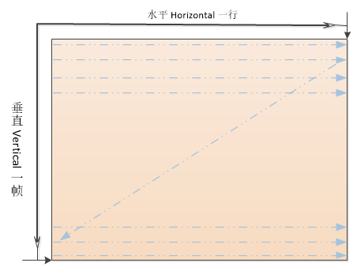
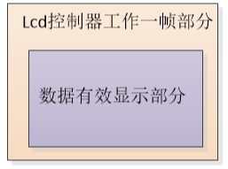

Slide 26

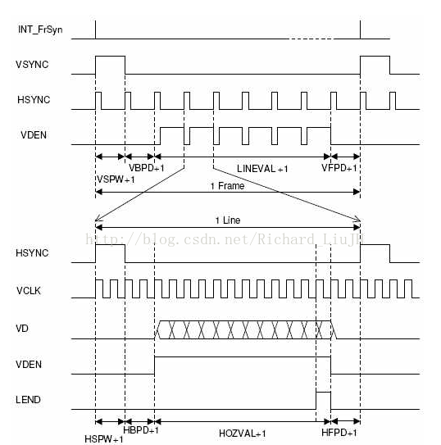

Slide 27
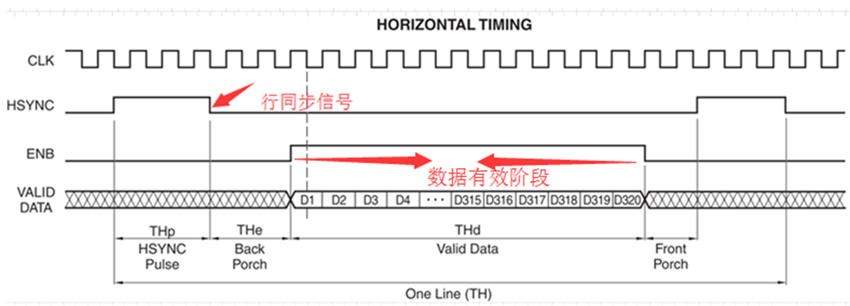

Slide 28
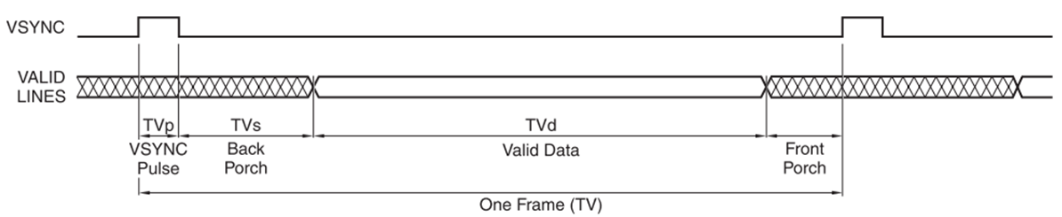

Slide 29
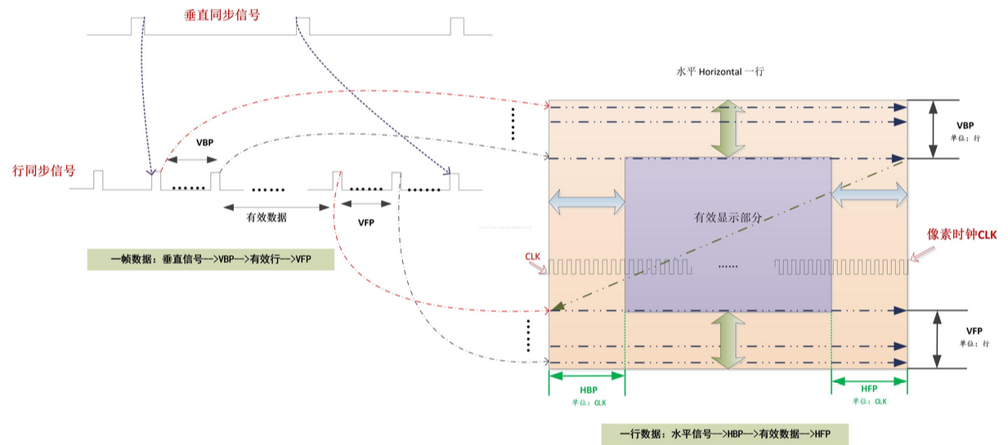

Slide 30

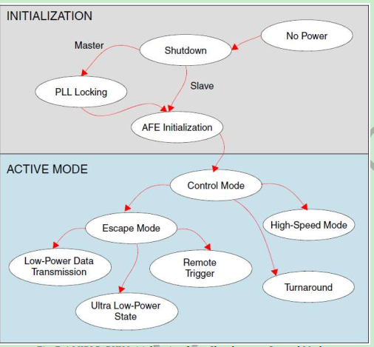

Slide 31
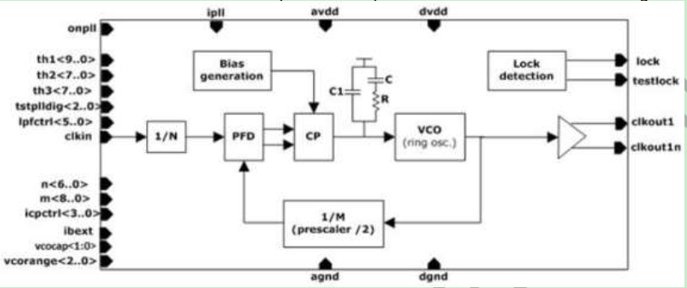
PLL locking

Slide 32
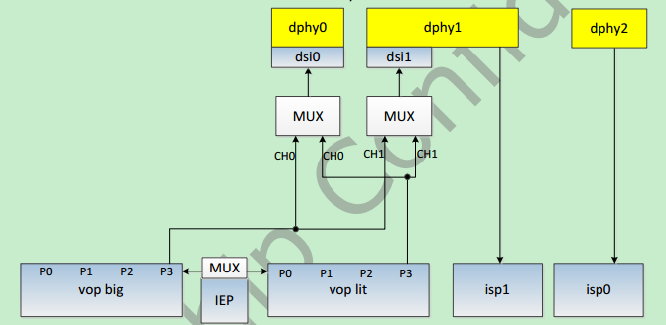
选择VOP ROUTE

Slide 33
Thank You !

